Slide 1

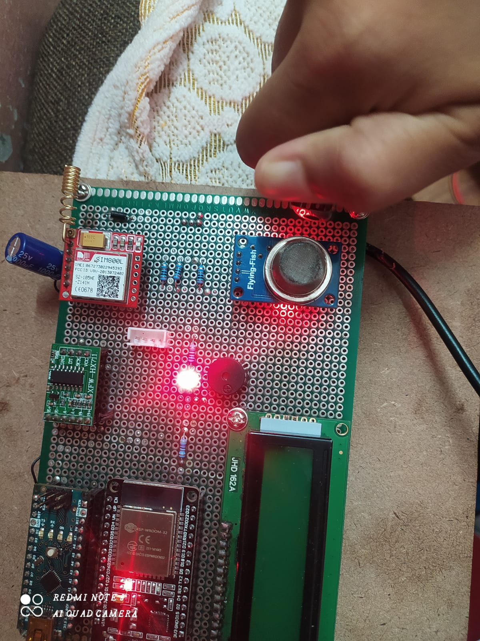
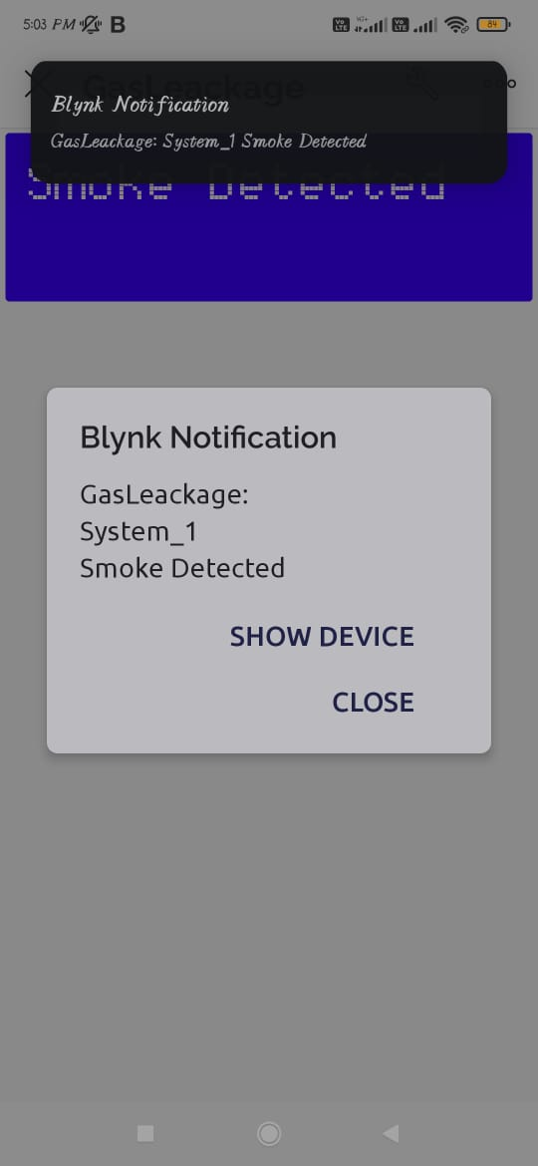
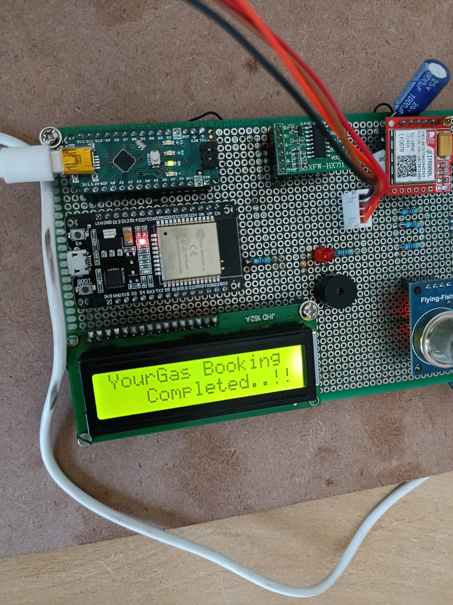
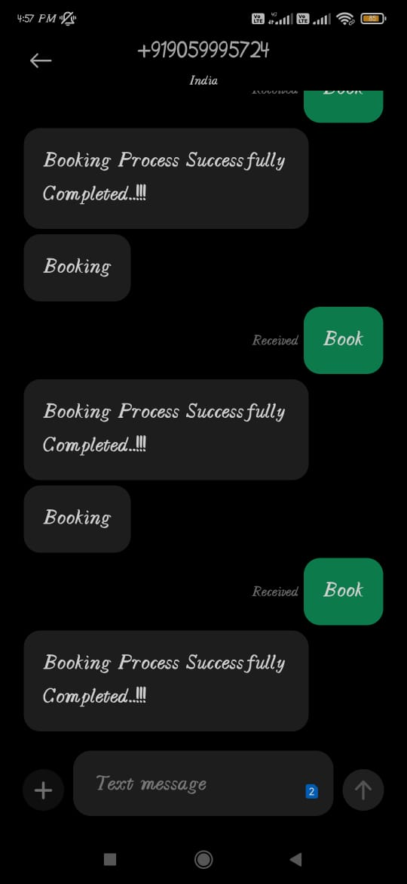
Department of Computer Science and Engineering
A Project
On
Gas Cylinder leakage Detection, Weight checking &
Automatic Cylinder Booking system over IOT
Description
This system alerts when the LPG gas is going to be leaking. Thereby, avoiding LPG leakage accidents and saving lives. This system having additional feature that is weight checking every time and gas booking alert is also sent to registered mobile number when the gas is going to be completing. So our idea will be very helpful for real life.
Project Guide
Dr. G. Rama Subba Reddy, M.E,Ph.D
Professor&Head
Student Roll No Name Of The Student
198R1A0540
198R1A0524
208R5A0501
198R1A0537
Y.Siva Kumari
P.Hima Bindu
G.Sreenivasulu
U.Laxman Sai Kiran

